Slide 3
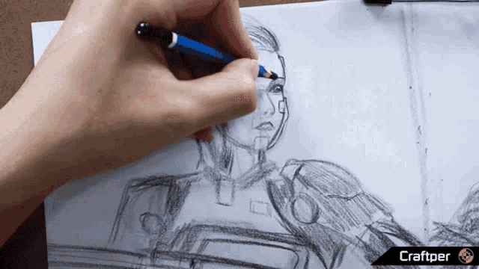

Slide 4
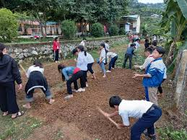

Slide 7
Unit 1: HOBBIES.
Lesson 1: Getting started: My favorite hobby

Slide 8
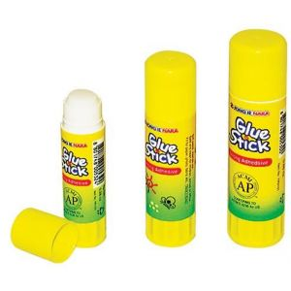
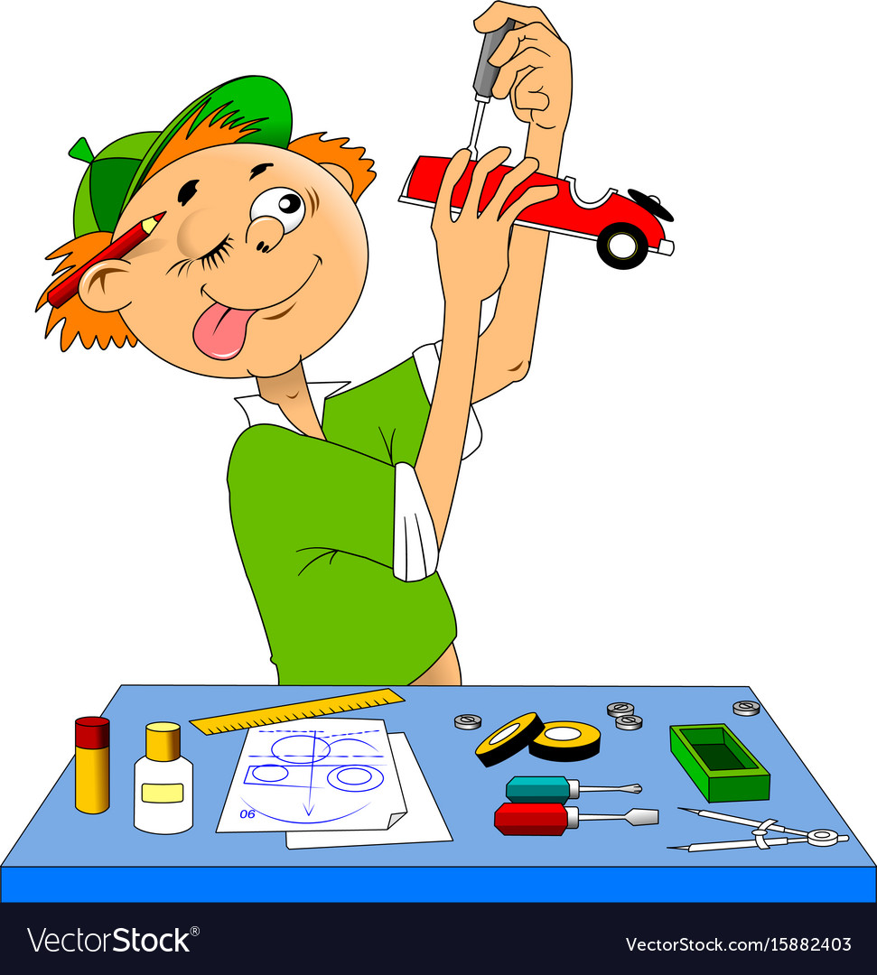
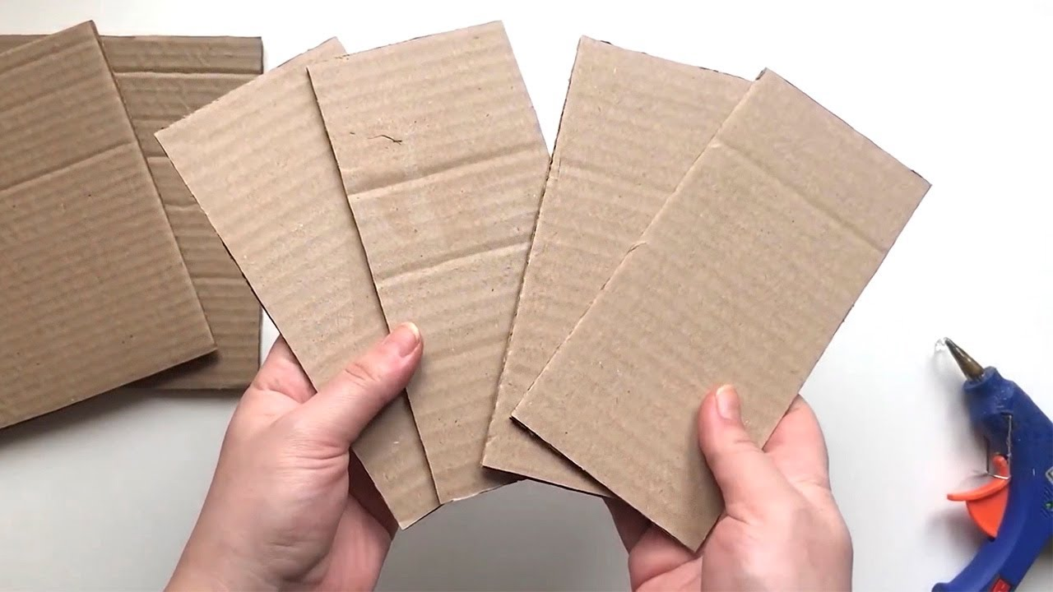
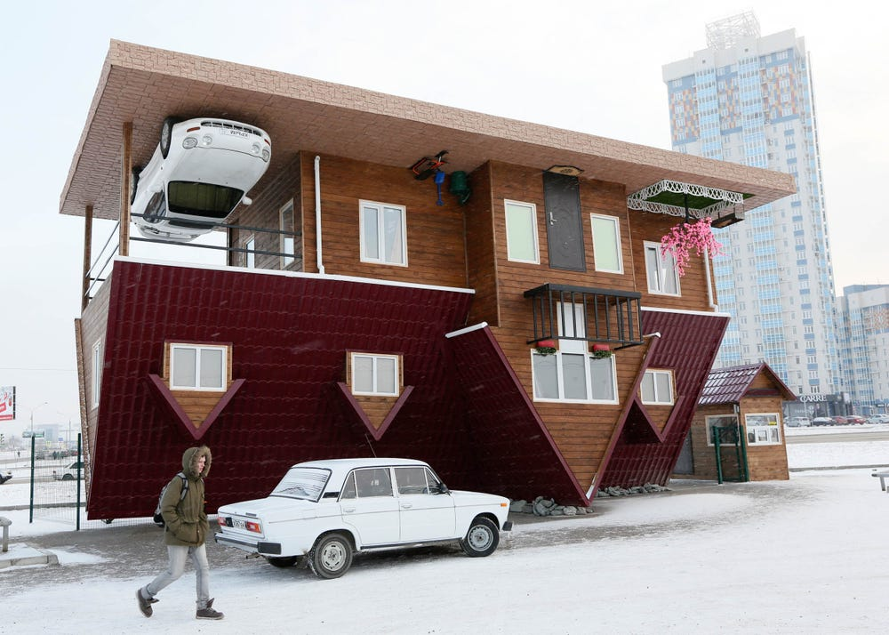
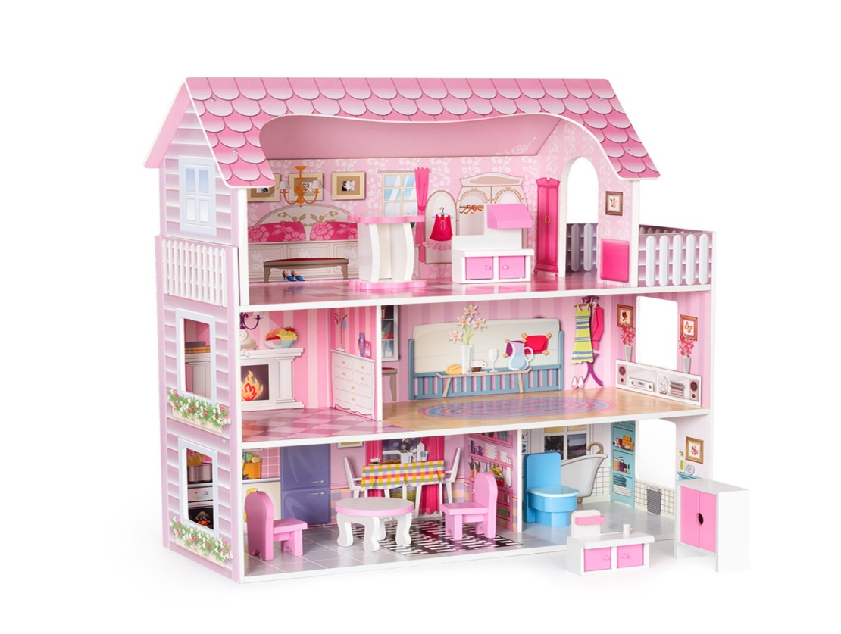
Unit
1
MY HOBBIES
Vocabulary:
- unusual (adj) /ʌnˈjuːʒuəl/ : khác thường
- creativity (n) /ˌkriːeɪˈtɪvəti/ sự sáng tạo
- dollhouse (n) / ˈdɒlhaʊs/ nhà búp bê
- cardboard (n) /ˈkɑːdbɔːd/bìa các tông
- glue (n) /ɡluː/ keo dán, hồ
making models /ˈmeɪkɪŋ ˈmɒdlz/ làm mô hình
LESSON 1: GETTING STARTED
Unit

Slide 9
New words | Pronunciation | Meaning
1. unusual (adj) | /ʌnˈjuːʒuəl/ | khác thường
2. creativity (n) | /ˌkriːeɪˈtɪvəti/ | sự sáng tạo
3. dollhouse (n) | /ˈdɒlhaʊs/ | nhà búp bê
4. cardboard (n) | /ˈkɑːdbɔːd/ | bìa các tông
5. glue (n) | /ɡluː/ | keo dán, hồ
6. making models | /ˈmeɪkɪŋ ˈmɒdlz/ | làm mô hình

Slide 10
What’s Trang’s hobby?
What’s Ann’s hobby?
Her hobby is building dollhouse
She likes horse riding

Slide 11
2. Read the conversation again and write T (True) or F (False).
2
1. Trang needs help with building dollhouses. ______
2. Trang uses glue and cardboard to build her dollhouse. ______
3. To build a dollhouse, you need to use your creativity. ______
4. Ann goes to a horse riding club every Sunday. ______
5. Ann’s lesson starts at 8 p.m. ______
F
T
T
T
F

Slide 12
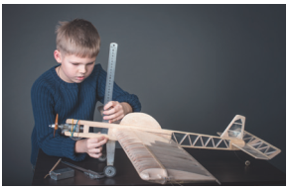
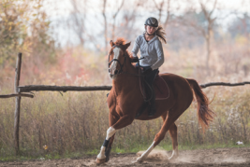
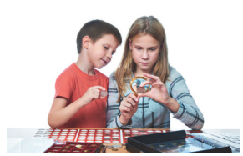
3. Matching the words and phrases with the correct picture
3
making models
riding a horse
collecting coins

Slide 13
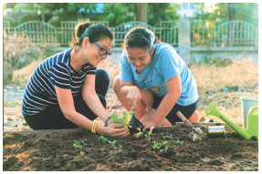
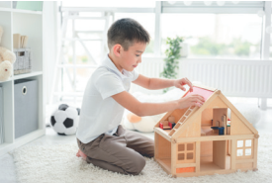
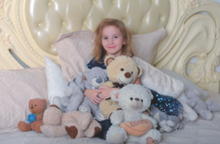
3. Matching the words and phrases with the correct picture
3
gardening
building dollhouses
collecting teddy bears

Slide 14
3
making models
riding a horse
collecting coins
gardening
building dollhouses
collecting teddy bears

Slide 15
Work in pairs. Write the hobbies from Task 3 in the suitable columns.
doing things | making things | collecting things
riding a horse
making models
collecting coins
gardening
building dollhouses
collecting teddy bears
(others: travelling, skiing, doing yoga, etc.)
(others: painting, making pottery, etc.)
(others: collecting toys, collecting books, etc.)

Slide 16
HOMEWORK
Name a list of cheap hobbies, expensive hobbies, easy and difficult hobbies.
Prepare the next lesson

Slide 17
Website: sachmem.vn
Fanpage: facebook.com/sachmem.vn/

