Slide 2
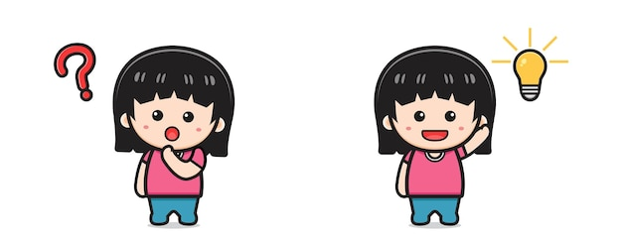
Guess What the hobby is?
The team with the most points is the winner.
Example:
A: Water, grow, flowers, vegetable.
B: Is it gardening?
A: Yes, it is.

Slide 3
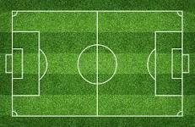
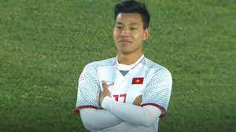
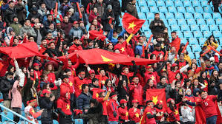
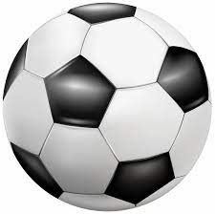
FOOTBALL

Slide 4
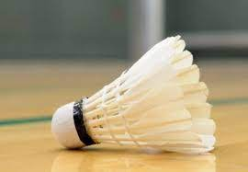
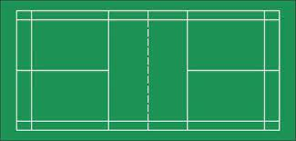
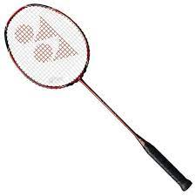
BADMINTON

Slide 5
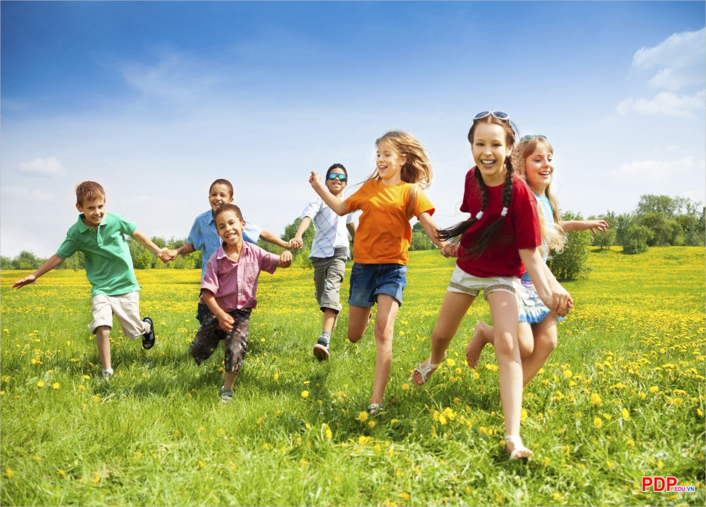
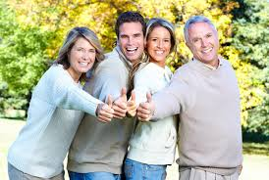
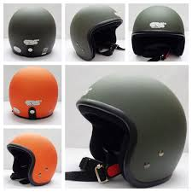
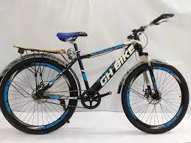
CYCLING

Slide 6
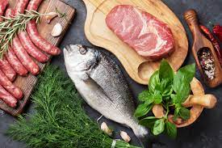
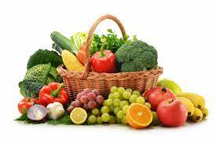
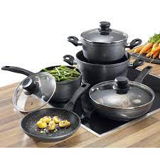
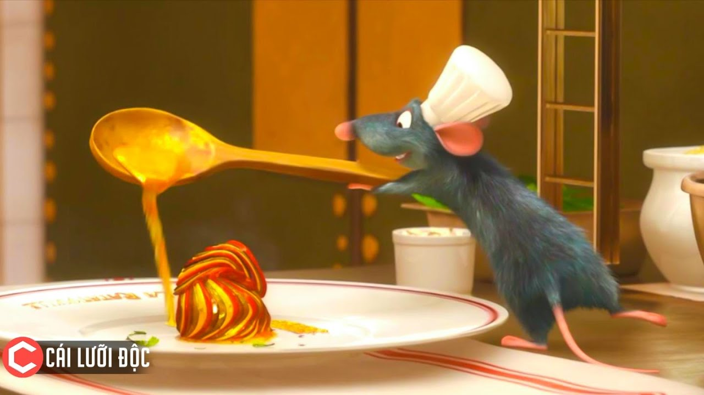
COOKING

Slide 7
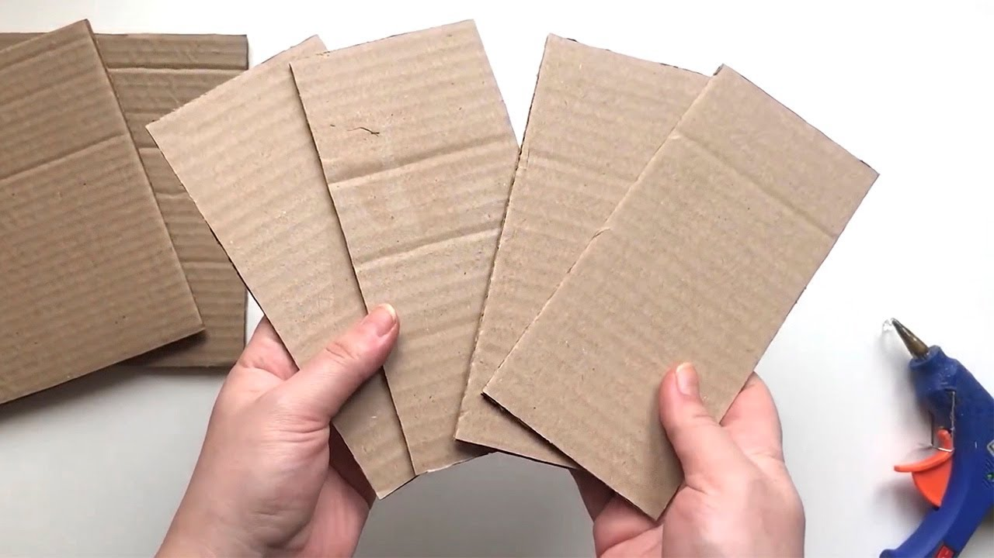
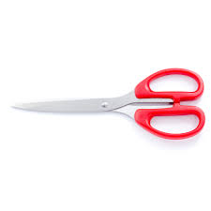
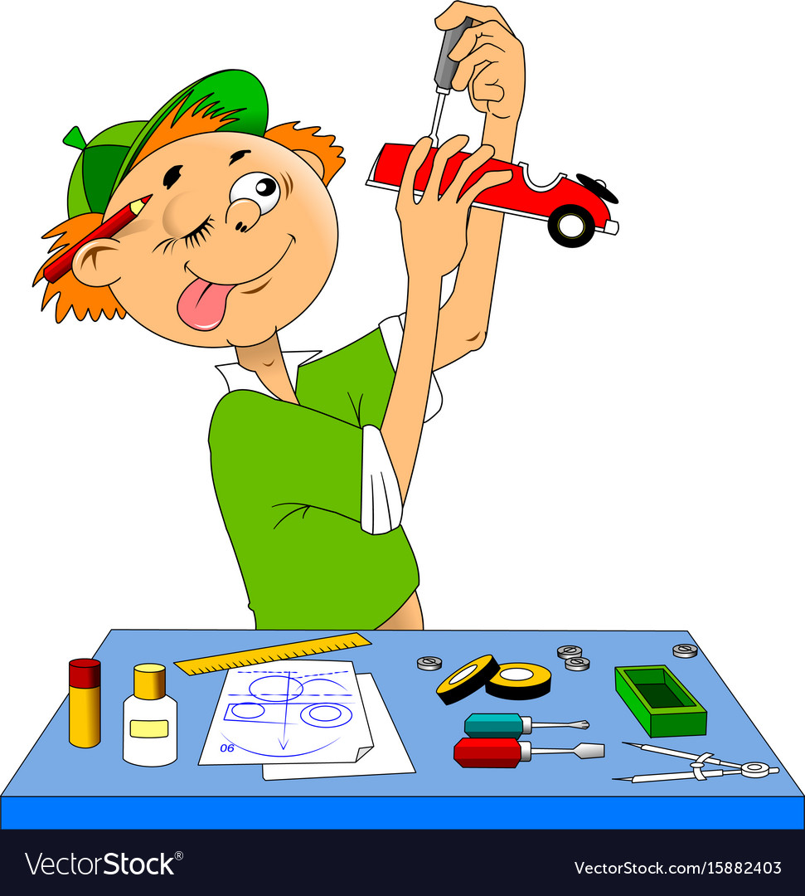
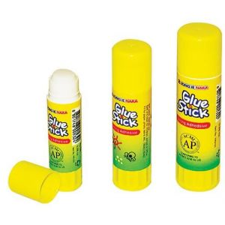
MAKING THINGS

Slide 8
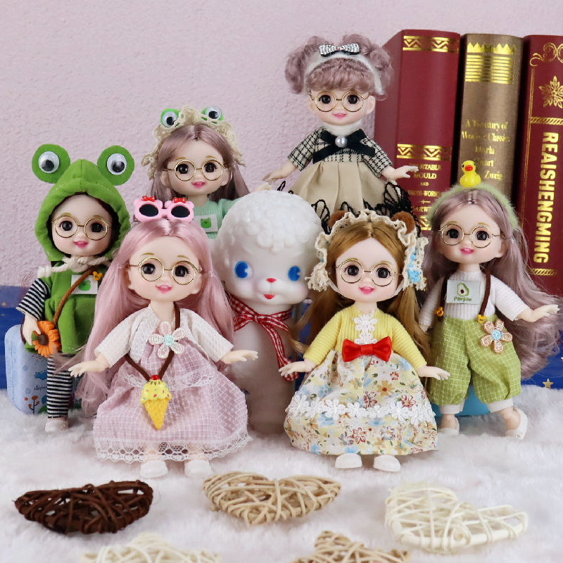
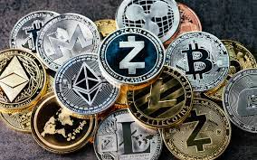
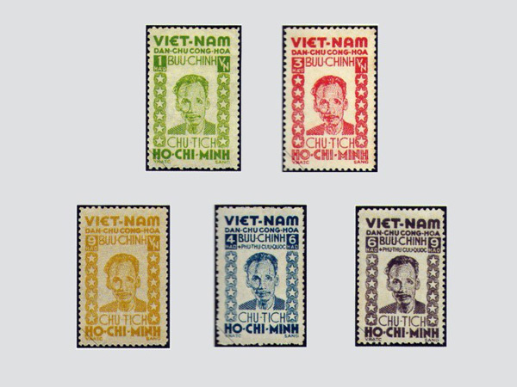
COLLECTING THINGS

Slide 9
1. Present simple
TO BE | VERBS
(+) S+ am/is/are +………. | (+) S + Verb(s/es)+………..
(-) S + am / is/ are + not+……. | (-) S + don’t/ doesn’t + verb+…….
(?) Am/is/are + S + ……? | (?) Do/ does + S + verb+…….?
Is used for something is a general truth
Example: The sun rises every morning
Is used for something that happens regularly in the present
Example: She goes swimming three times a week
Is used for timetables or programmes
Example: The cooking lesson starts at 9 a.m

Slide 10
2. Practice:
* Task 1 : Matching
b
a
c
a
b

Slide 11
2. Practice
*Task 2.Complete the sentences.
1. My brother and I (make) ____a new model every month. 2. What ____Lan (do) ___ in her free time? 3. I (have) _____ a drawing lesson every tuesday. 4. Mark (not like) ________ doing judo. 5. ___ your English lesson (start) ____ at 6 p.m.?
make
does
do
have
doesn’t like
Does
start

Slide 12
2. Practice
* Task 3 : Fill in each blank.
My family members have different hobbies. My dad (1. enjoy) _____ gardening. He (2. spend) _____ two hours in our garden every day. My mum and sister (3. not like) _______ gardening, but they love cooking.They (4. go) ___to a cooking class every Sunday. Their lesson (5. begin) _____ at 9 a.m. I (6. not enjoy) ________ cooking, and I cannot cook very well.
enjoys
spends
don’t like
go
begins
don’t enjoy

Slide 13
PRACTICE
4
Write complete sentences, using the given words and phrases. You may have to change the words or add some.
1. sun / set / in / west / every evening. __________________________________________________________ 2. Trang and Minh / play / basketball / every day / after school? __________________________________________________________ 3. flight / from / Ho Chi minh City / not arrive / 10:30. __________________________________________________________ 4. our science teacher / start / our lessons / 1 p.m. / on Fridays. __________________________________________________________ 5. you / make / model / at / weekend? __________________________________________________________
The sun sets in the west every evening.
Do Trang and Minh play basketball every day after school?
The flight from Ho Chi Minh City doesn’t arrive at 10:30.
Our science teacher starts our lessons at 1 p.m. on Fridays.
Do you make models at the weekend?

Slide 14
2
HOMEWORK
Complete exercises in the Workbook.

Slide 15
Website: sachmem.vn
Fanpage: facebook.com/sachmem.vn/

