Slide 2
WHAT HOBBY IS IT?

Slide 3
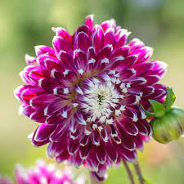

Slide 4
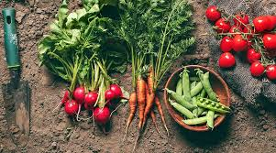

Slide 5
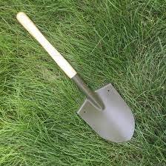

Slide 6
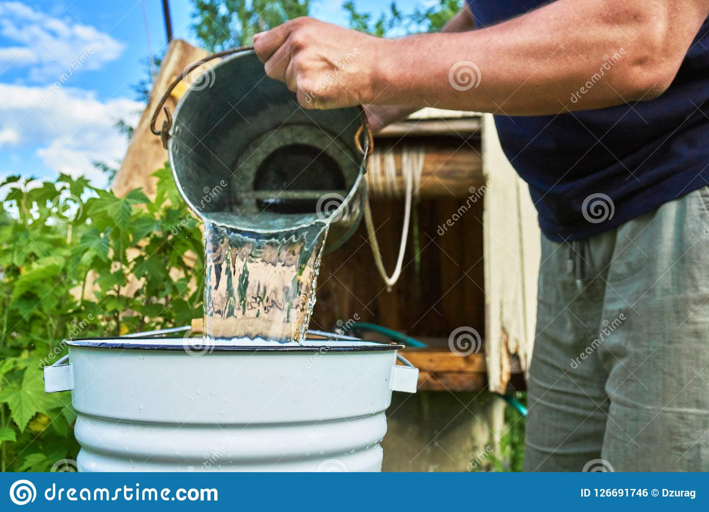

Slide 7
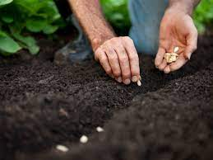

Slide 8
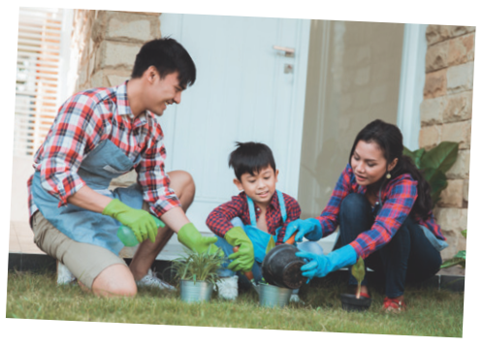
what is good about gardening?

Slide 9
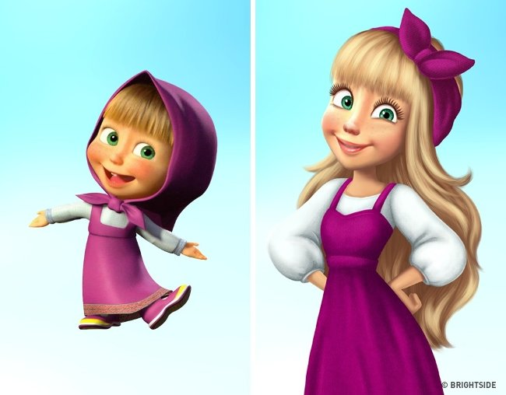
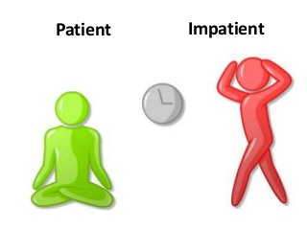
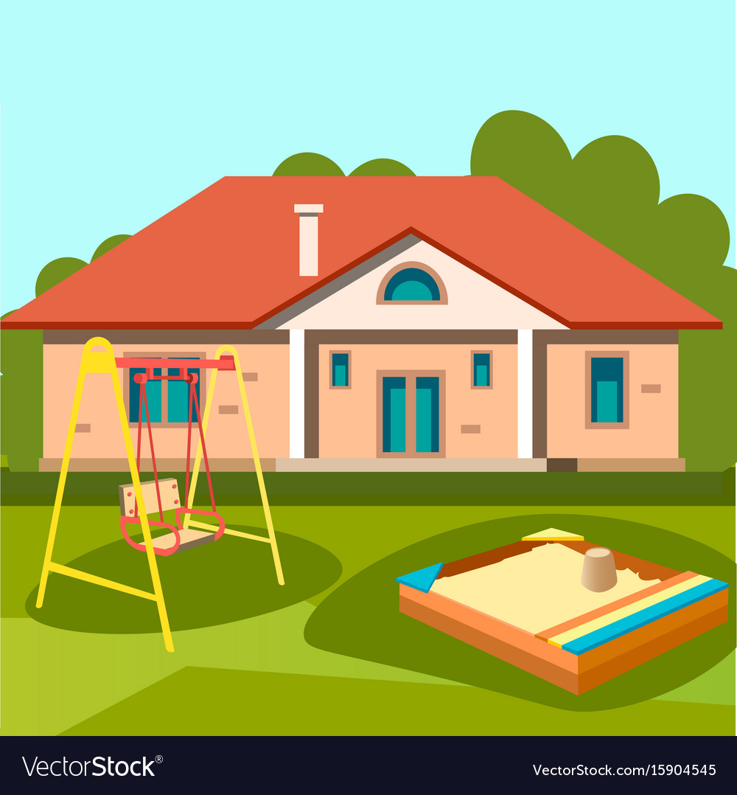
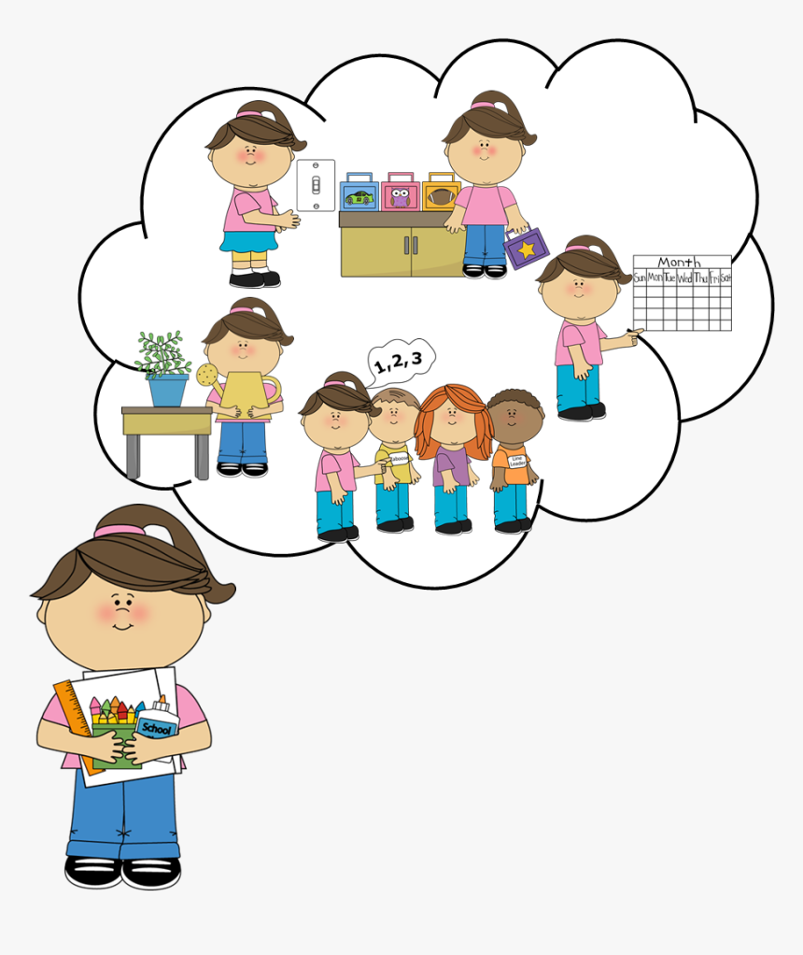
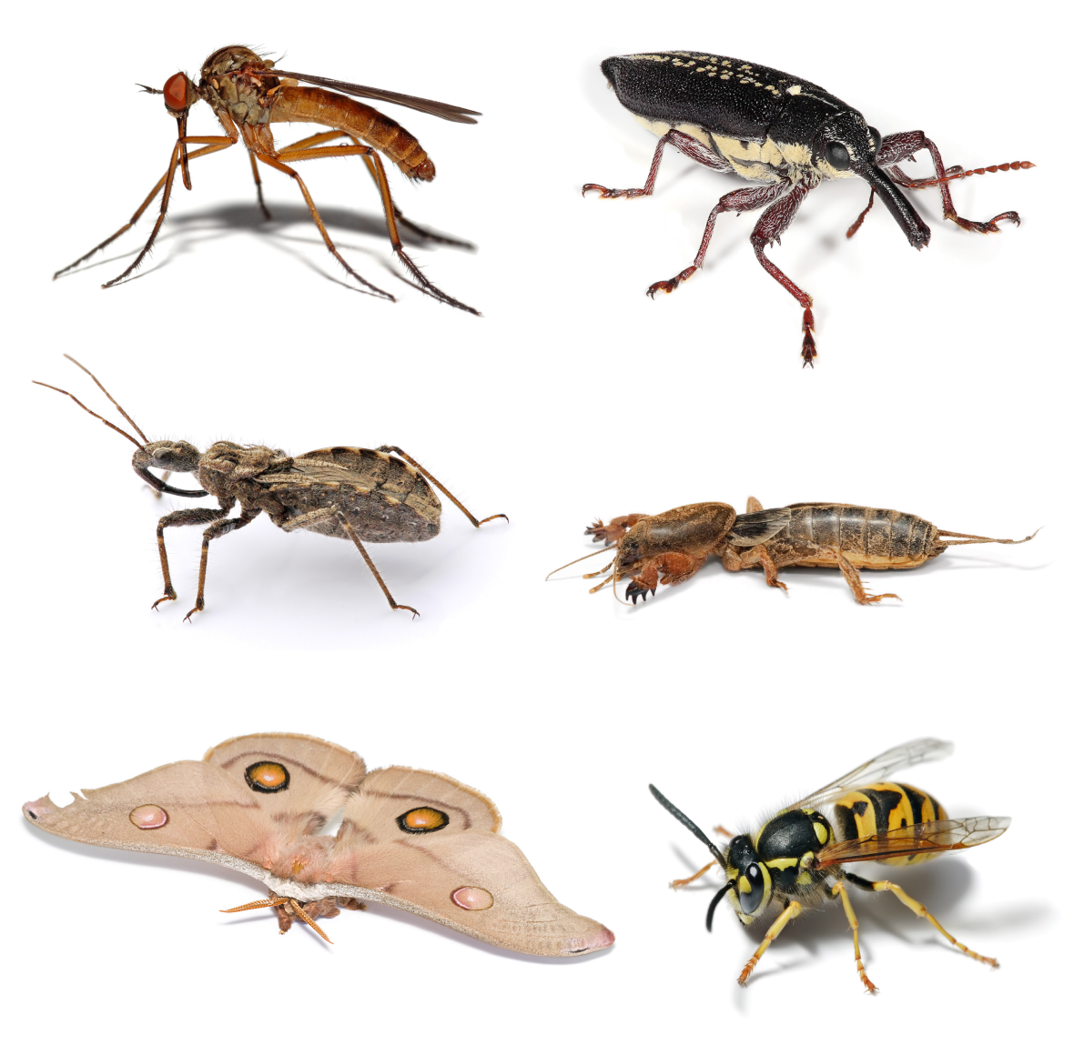
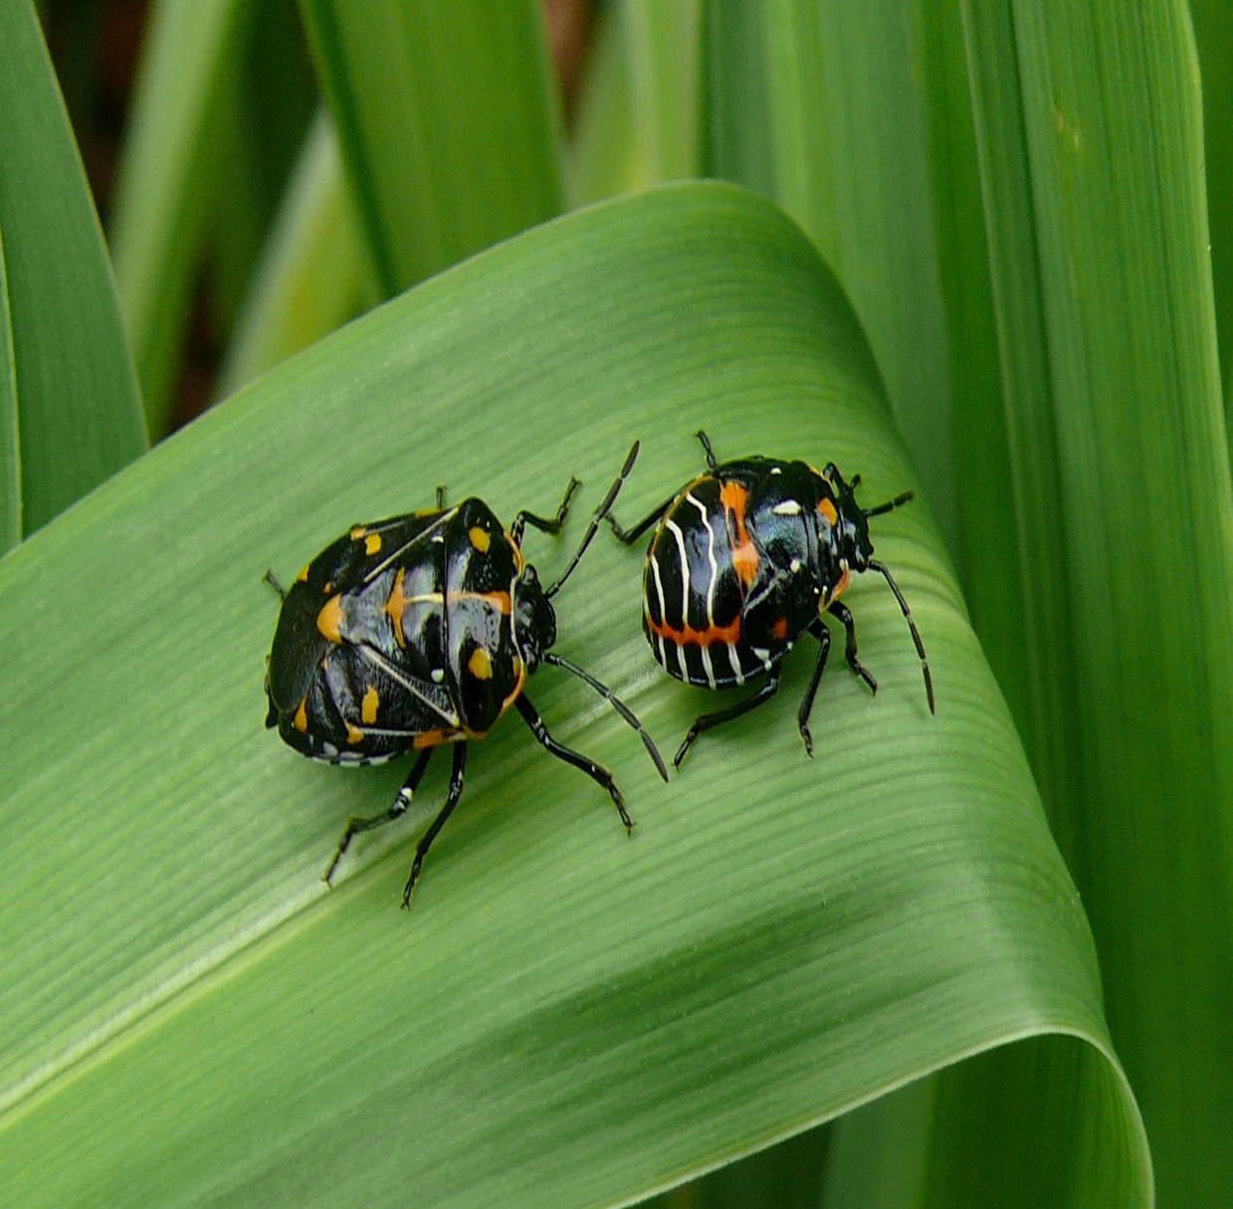
UNIT 1: HOBBIES.
LESSON 4: SKILLS 1

Slide 10
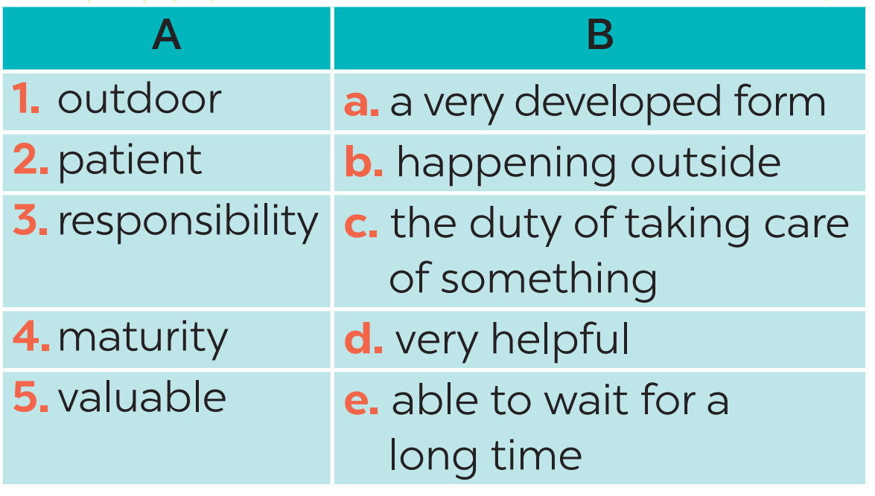
2. Match each word in column A with its definition in column B.

Slide 11
3 . Complete each sentence with no more than THREE words.
doing things
1. Gardening belongs to the group of __________. 2. Gardening teaches children about flowers, fruits, vegetables, _____________ . 3. Gardening makes children become ______and responsible. 4. It is an activity that everyone in the family can _____. 5. The author and her mother usually garden for _______a day.
insects and bugs
patient
join in
an hour

Slide 12
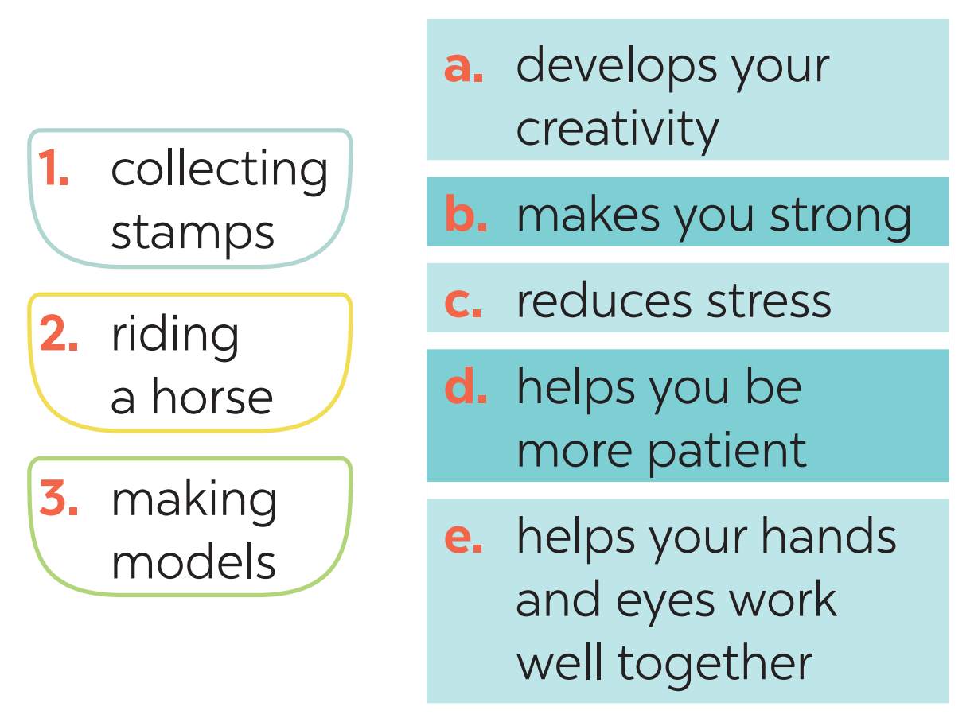
4. Match each hobby with its benefit(s). One hobby may have more than one benefit

Slide 13
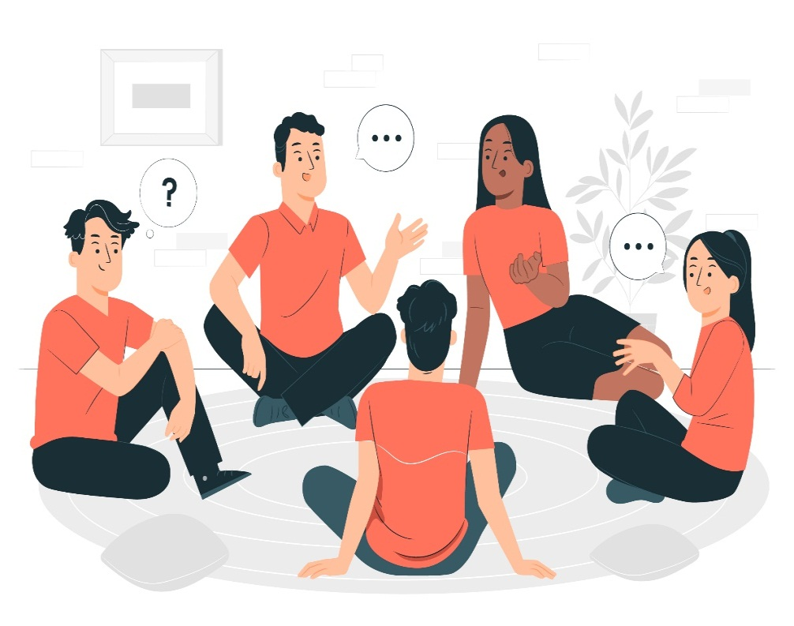
5. SPEAKING
What is your favourite hobby?
What are its benefits?
5
Example: Mi’s favourite hobby is collecting stamps.It helps her be more patient.

Slide 14
HOMEWORK
Write down your opinions about carving eggshells.
Search for more information about this unique hobby.

Slide 15
Website: sachmem.vn
Fanpage: facebook.com/sachmem.vn/

