Slide 2
GUESSING GAMES

Slide 3
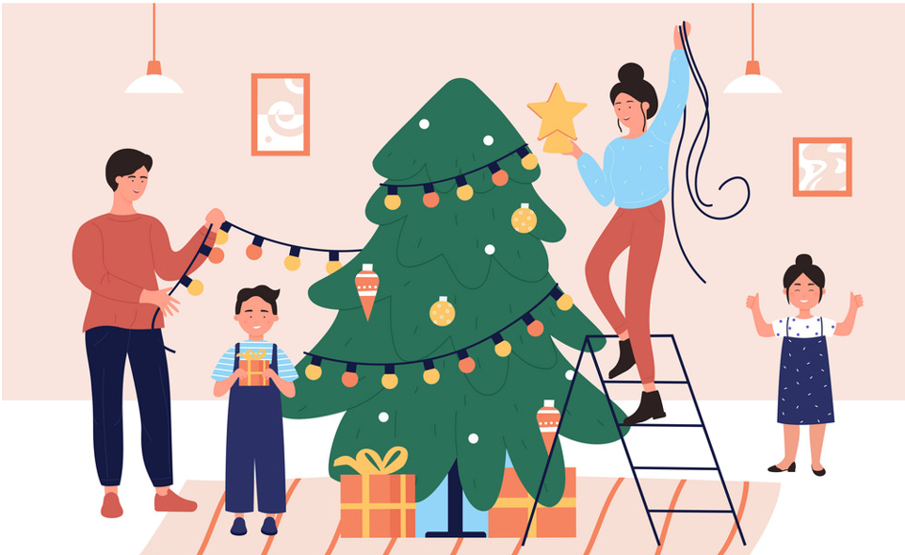
UNIT 1: HOBBIES
LESSON 6: SKILLS 2
Vocabulary:
- decorate (v) /ˈdekəreɪt/trang trí
- benefit (n) /ˈbenɪfɪt/ lợi ích
- article (n) /'ɑ:tikl/ : bài báo
- realative (n) /'relətiv/: bà con, họ hàng
- reduce stress: giảm căng thẳng

Slide 4
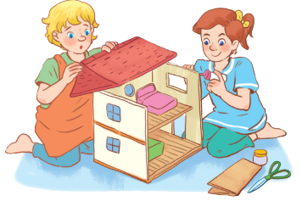
What hobby is it?
Do you think it is a good hobby? Why or why not?

Slide 5
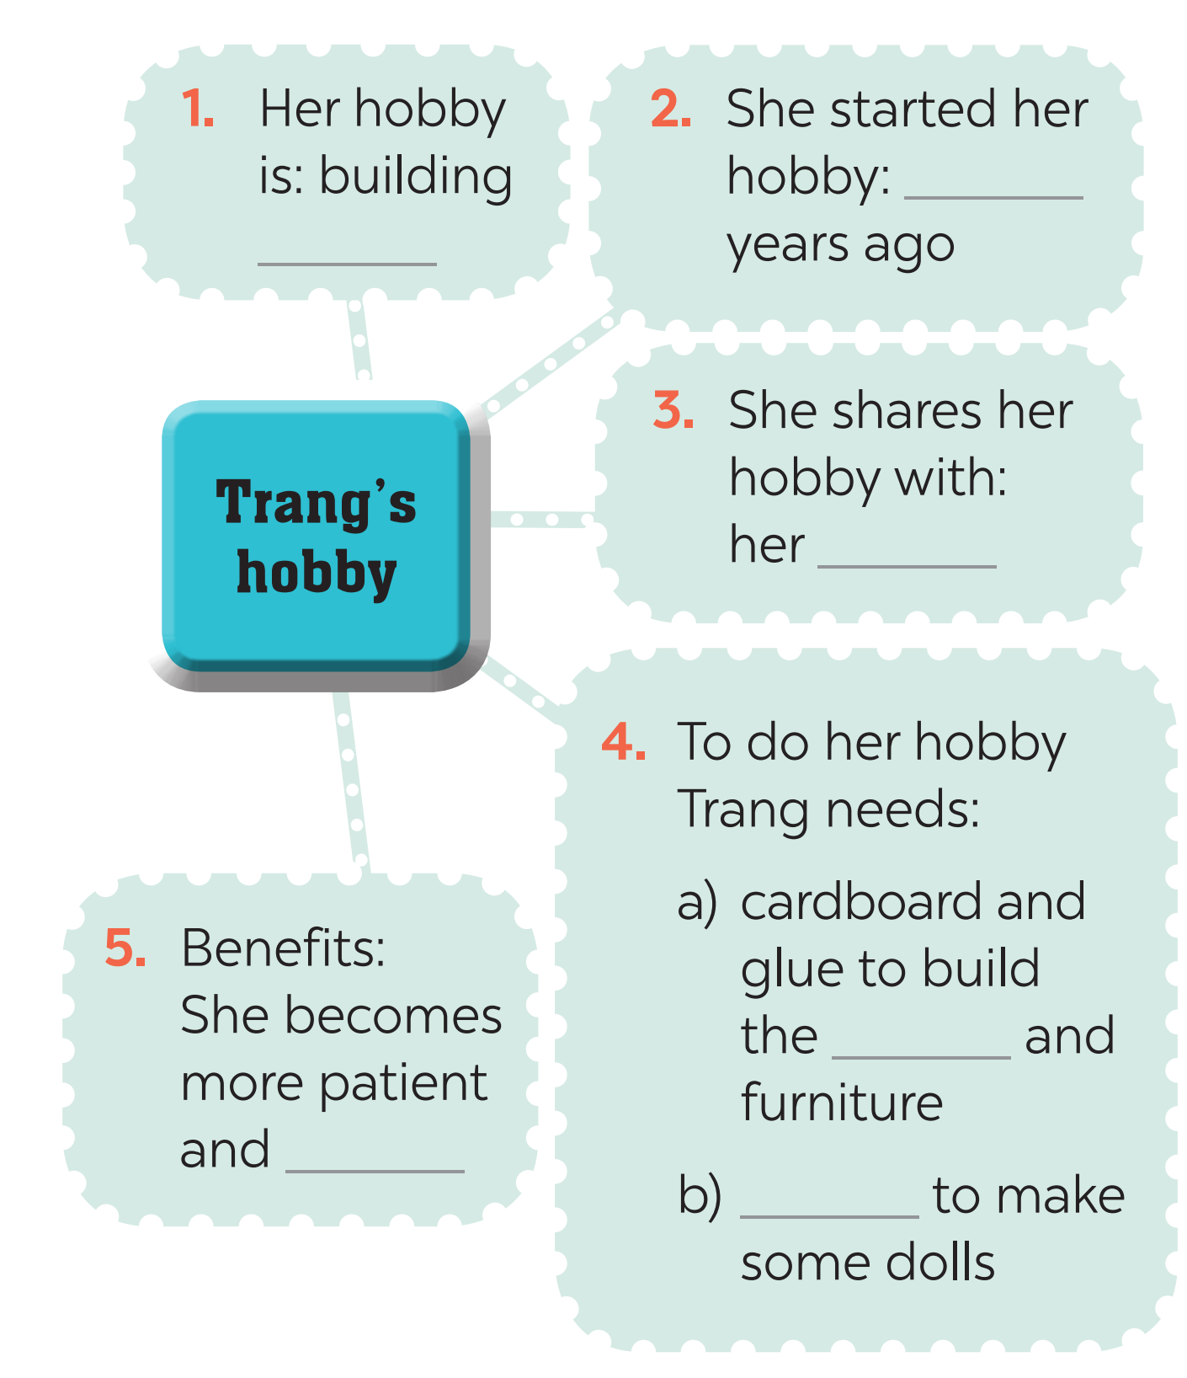
2. Listen and fill in each blank with one word or number.
three
dollhouses
cousin
house
creative
cloth

Slide 6
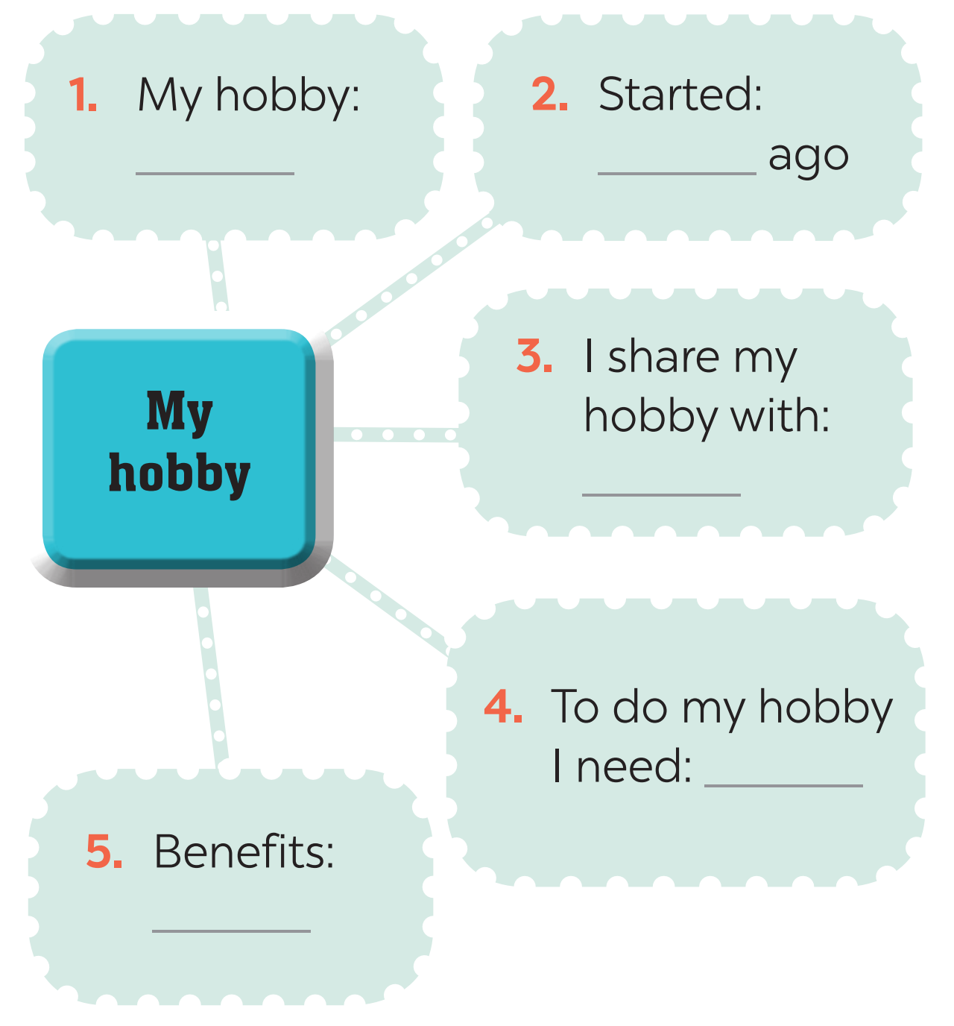
3. What is your hobby? Fill in the blanks below.

Slide 7
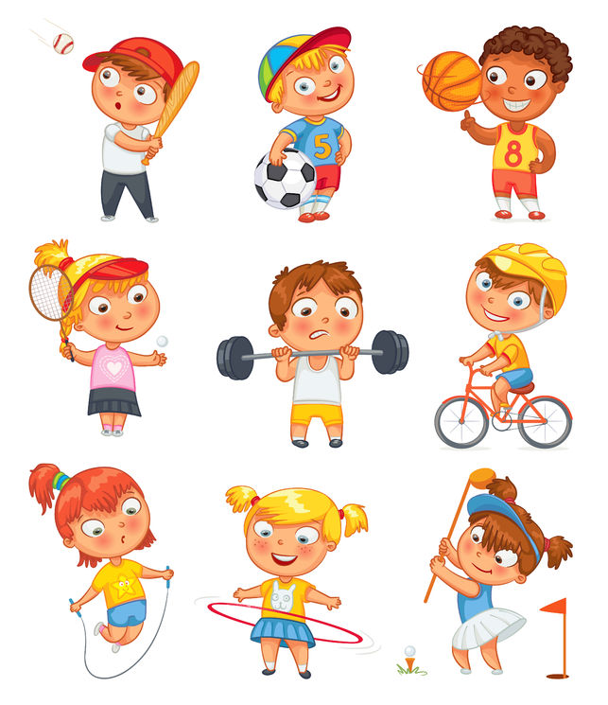
4. Now write a paragraph of about 70 words about your hobby. Use the notes in Task 3.
4
My hobby is ___________________________________ ___________________________________________________ ___________________________________________________ ___________________________________________________ ___________________________________________________ ___________________________________________________ ___________________________________________________

Slide 8
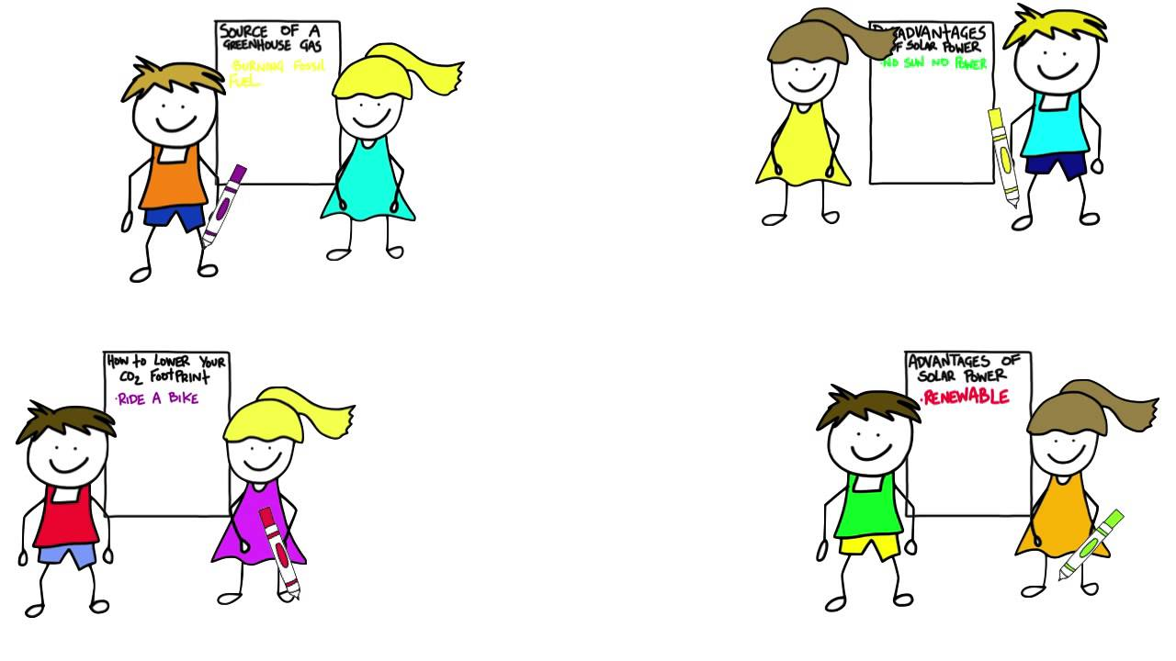
PRODUCTION
CLASS GALLERY
Students can:
go and see others’ work
give comments to one another

Slide 9
HOMEWORK
2
Prepare for the next lesson: Looking back & Project

Slide 10
Website: sachmem.vn
Fanpage: facebook.com/sachmem.vn/

